Slide 1
Building a Rod
Part 1
By JOHN STURM

Slide 2
Building Custom Fishing Rods
Rod types:
Spinning Rods
Casting Rods
Fly Rods

Slide 3
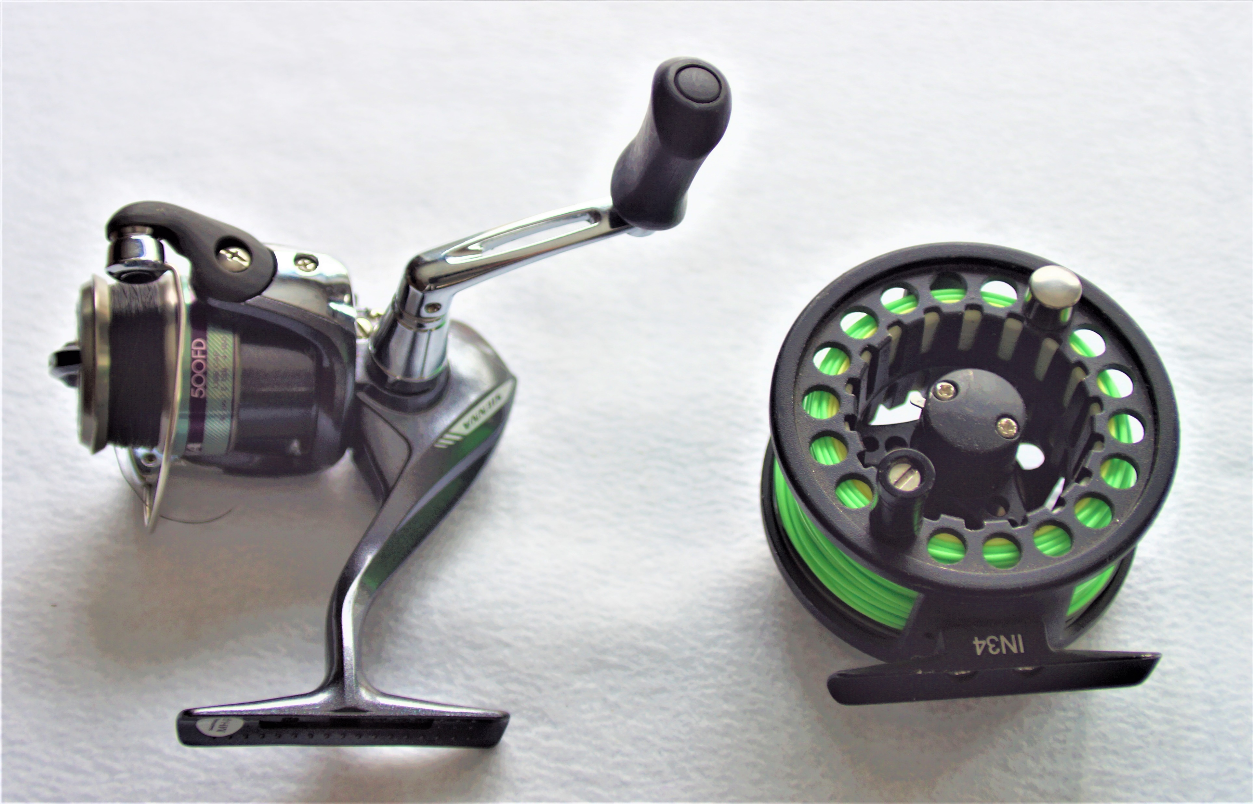
Spinning Rods need a Open Face Spinning Reel (Left reel). Fly Rods use a Fly Reel (Right Reel).

Slide 4
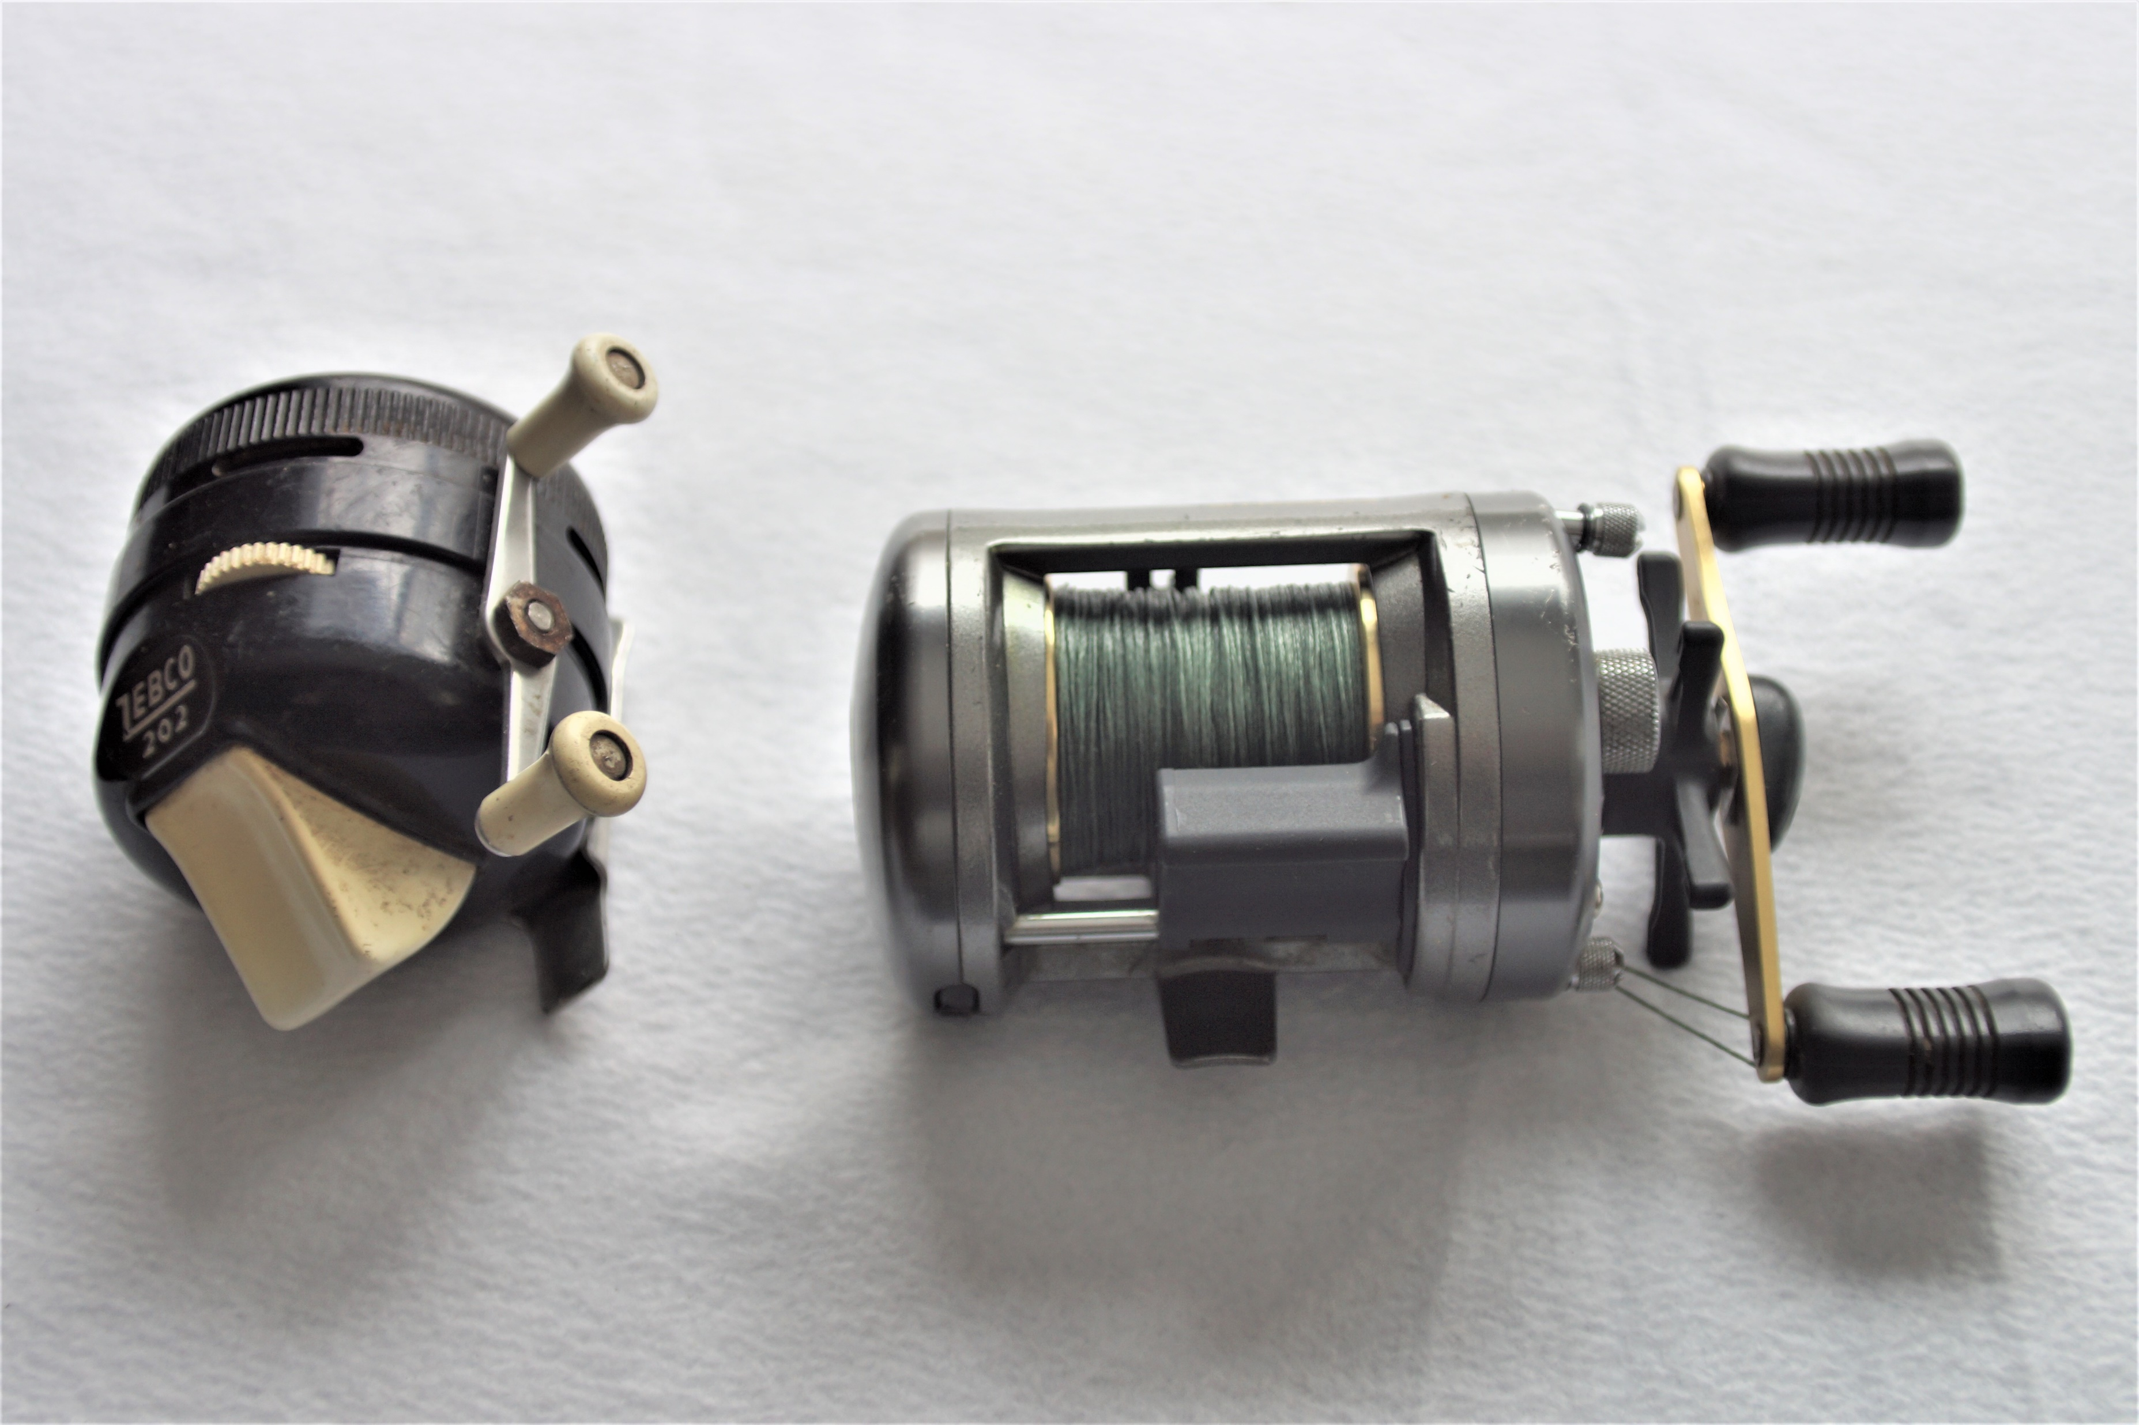
Casting Rods require either a Bait Casting Reel or a push button Closed Face Spinning Reel.

Slide 5
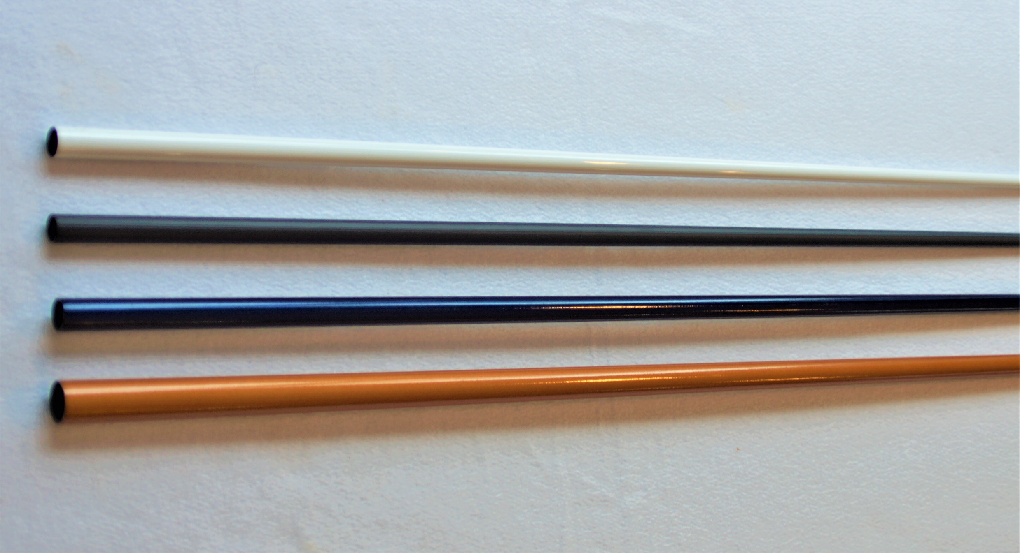
Rod Components: Rod Blanks
Rod blanks are the key component of a rod. They are selected based on the kind of fish you want to catch and the technique of fishing that you want to use.

Slide 6
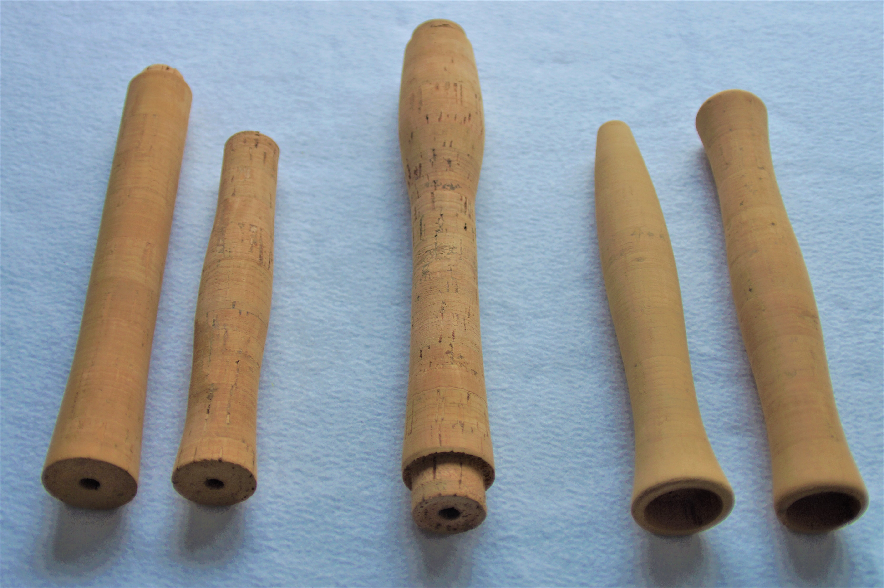
Rod Components: Rod Grips
The right two grips are spinning style grips. The center grip is a casting grip. The right two grips are fly rod grips.

Slide 7
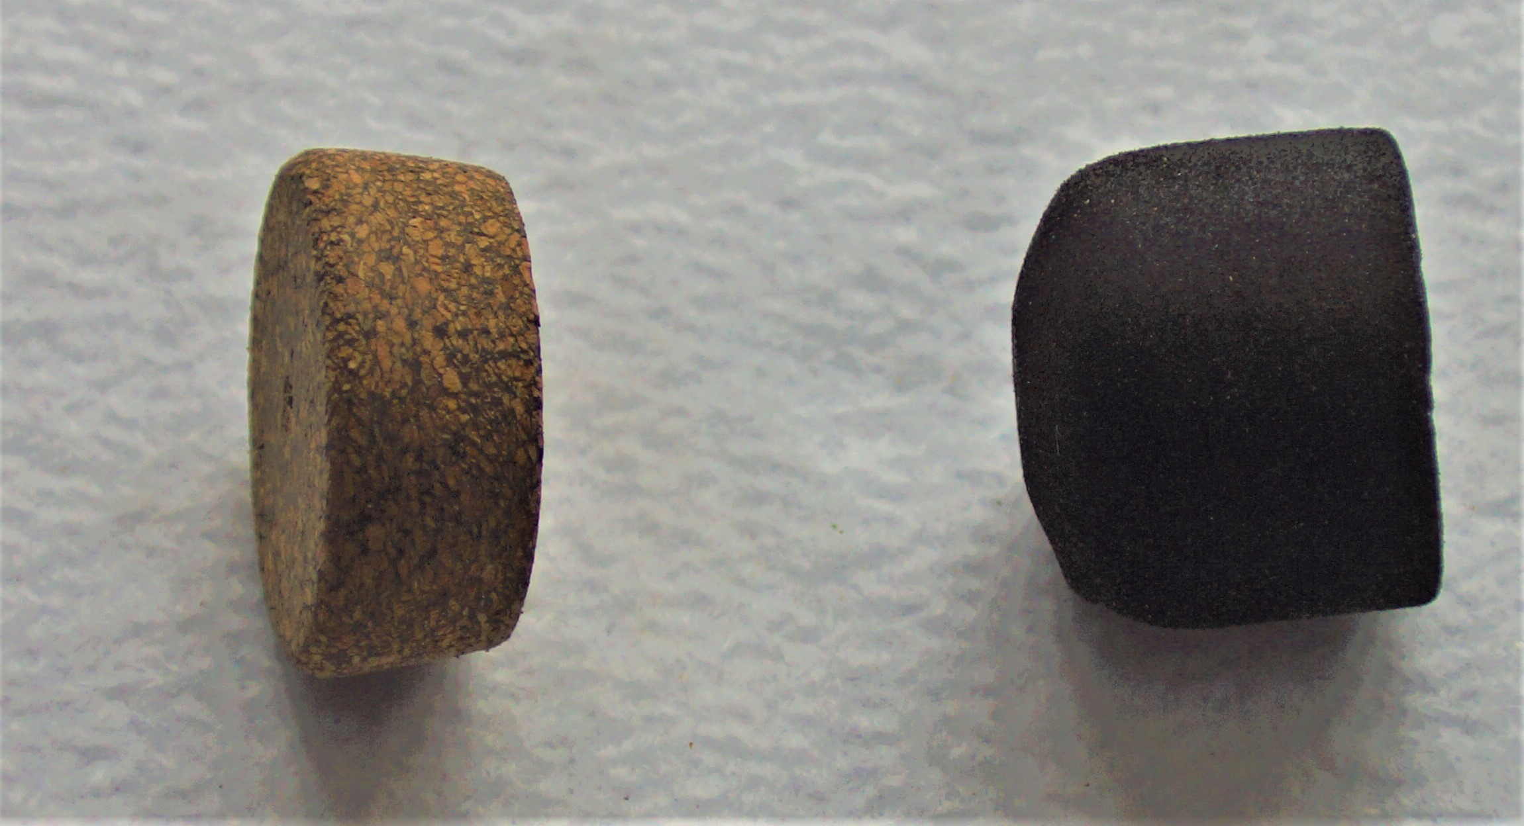
Rod Components: Grip End Caps
Two different styles and types of end caps. The left one is made of rubberized cork. The right one is EVA foam.

Slide 8
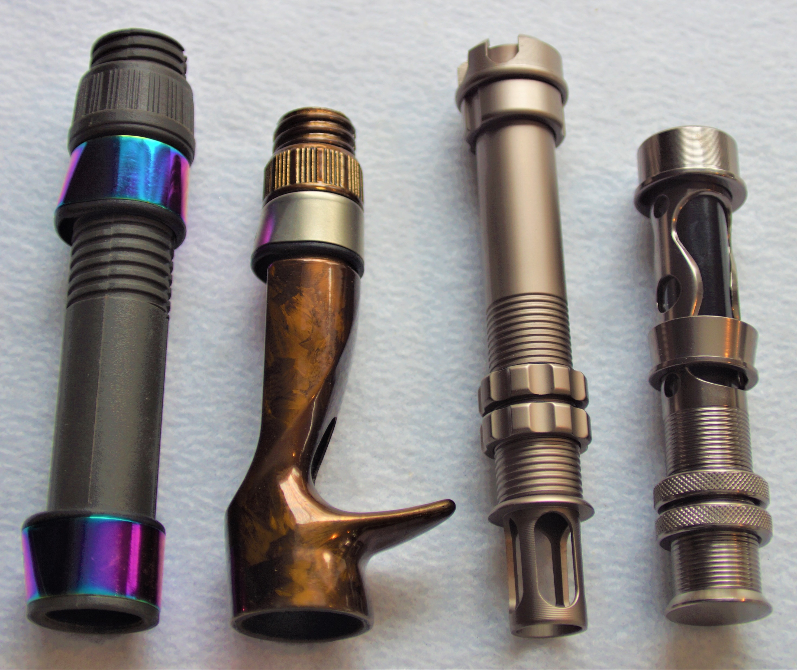
Rod Components: Reel Seats
The left reel seat is a spinning reel seat. The brown colored one with the trigger is a casting reel seat. The remaining two are fly rod reel seats. Of these two, the left one is a heavier action seat for fighting larger fish on a fly rod. The right one is for small to medium sized fish.

Slide 9
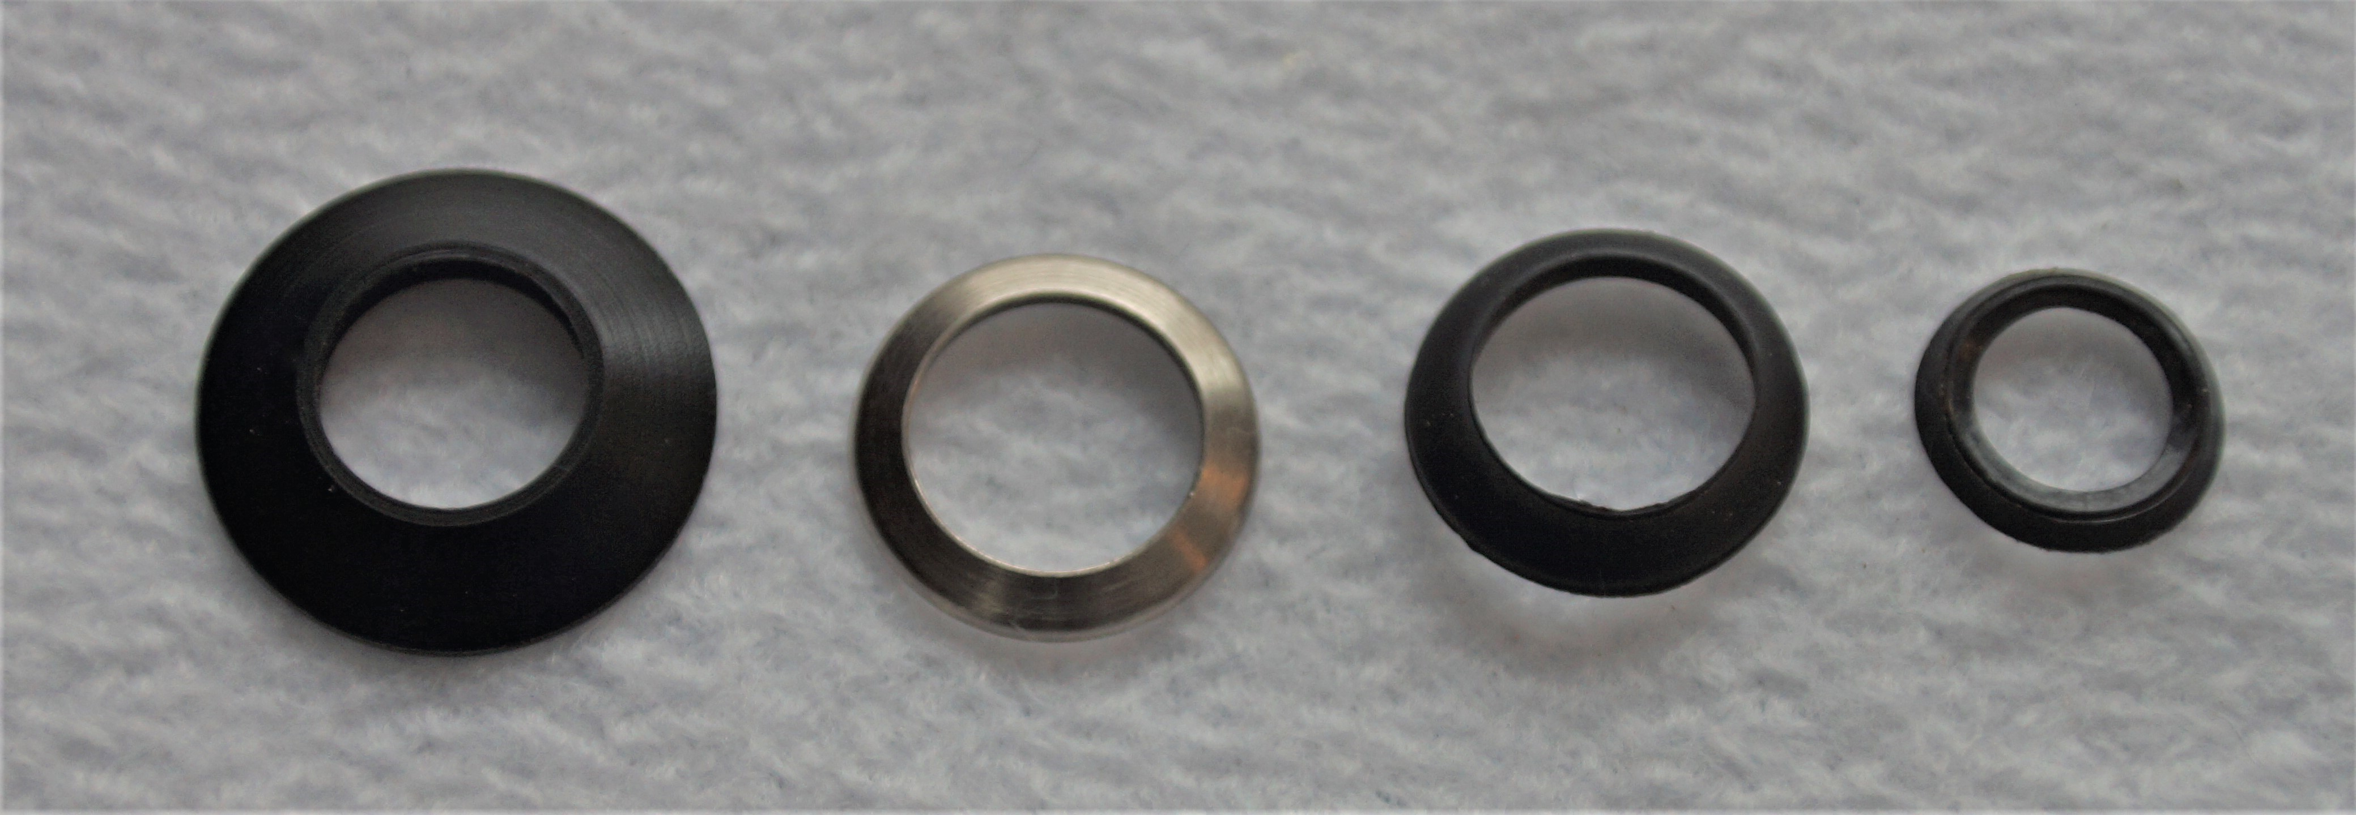
Rod Components: Winding Checks
Winding checks are used to transition from the fore grip to the rod blank. They are made of plastic, metal, rubber, and other materials. Their function is only to help make the rod look nice.

Slide 10
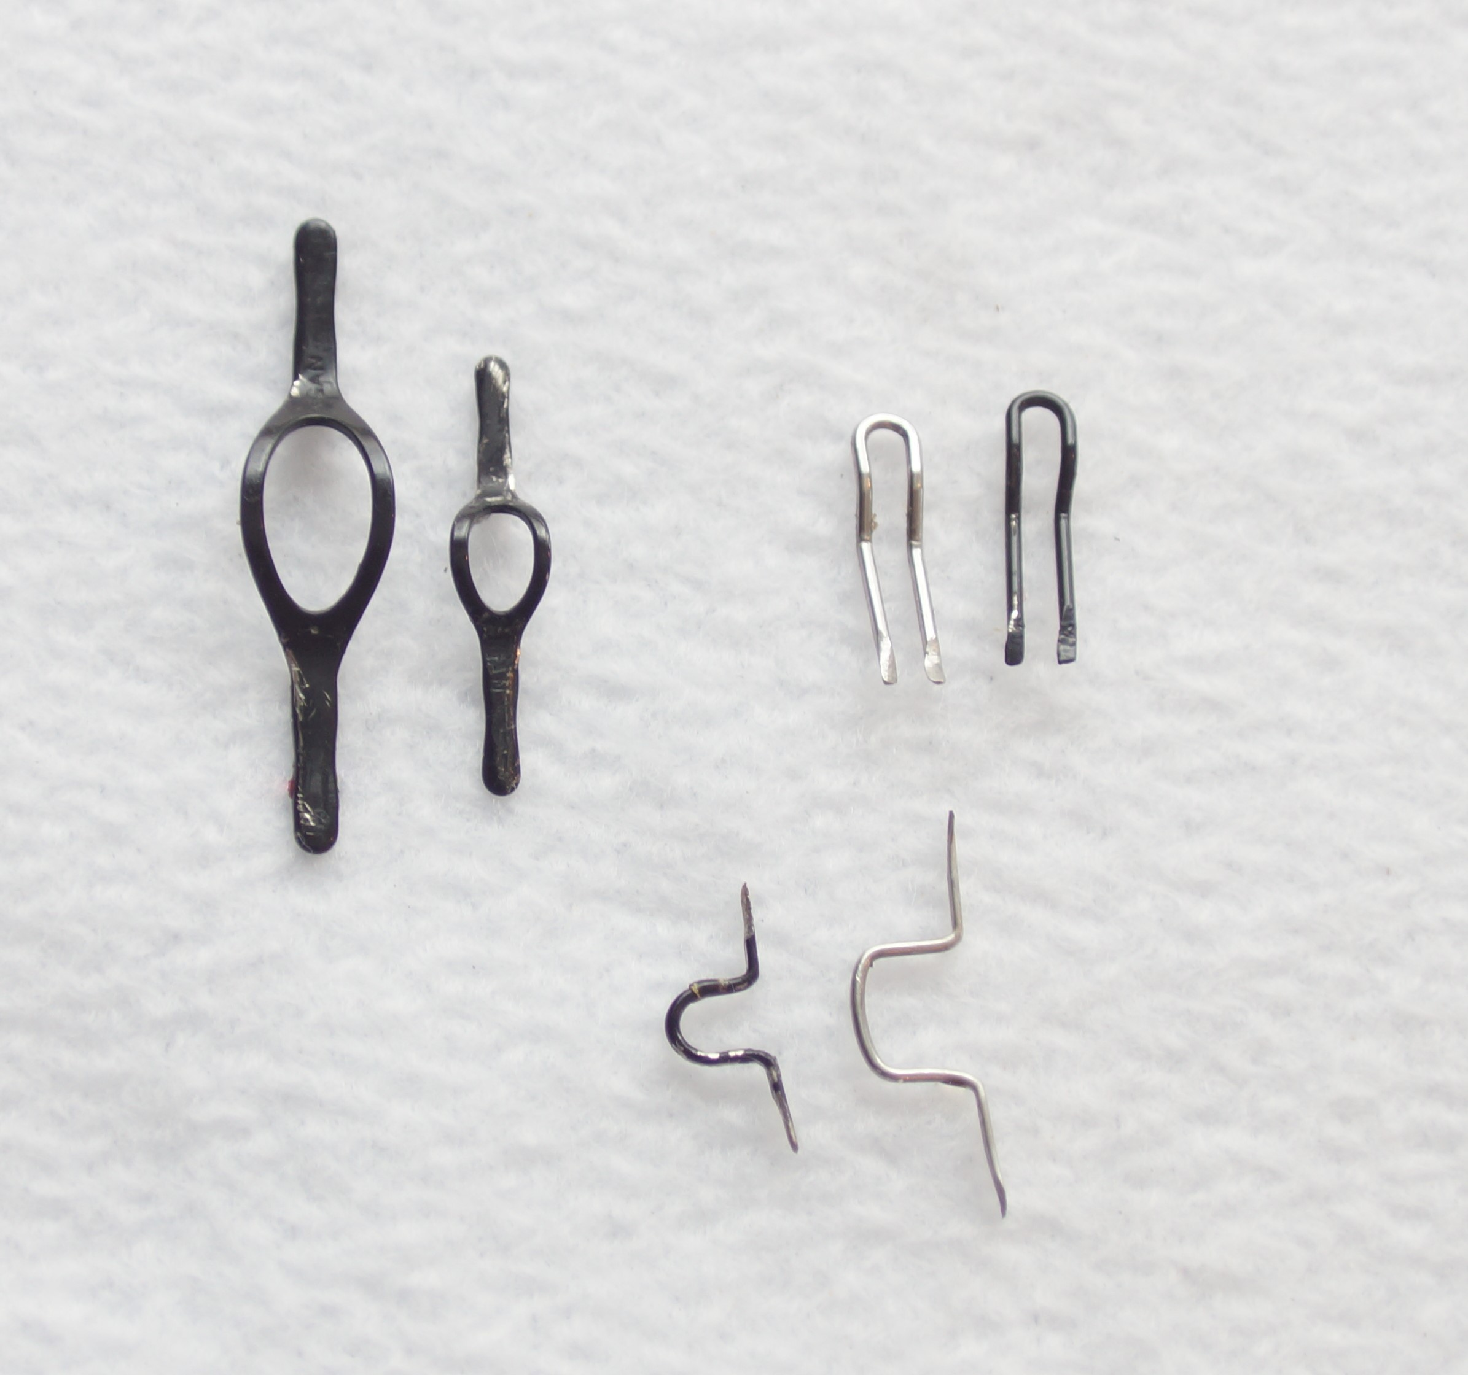
Rod Components: Hook Keepers
Hook Keepers come in many different styles and sizes. They are placed just ahead of the grips and winding check. They are used to hold your hook, lure, or fly when you are not fishing with them.

Slide 11
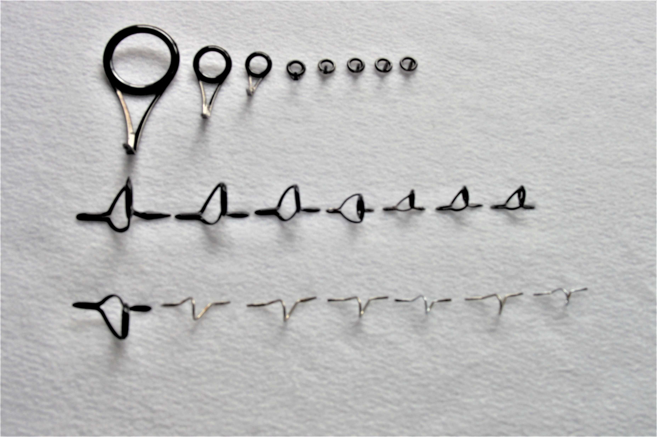
Rod Components: Guides
The top row is Spinning guides. The center row is Casting guides. The bottom row is a typical set of Fly Rod guides.

Slide 12
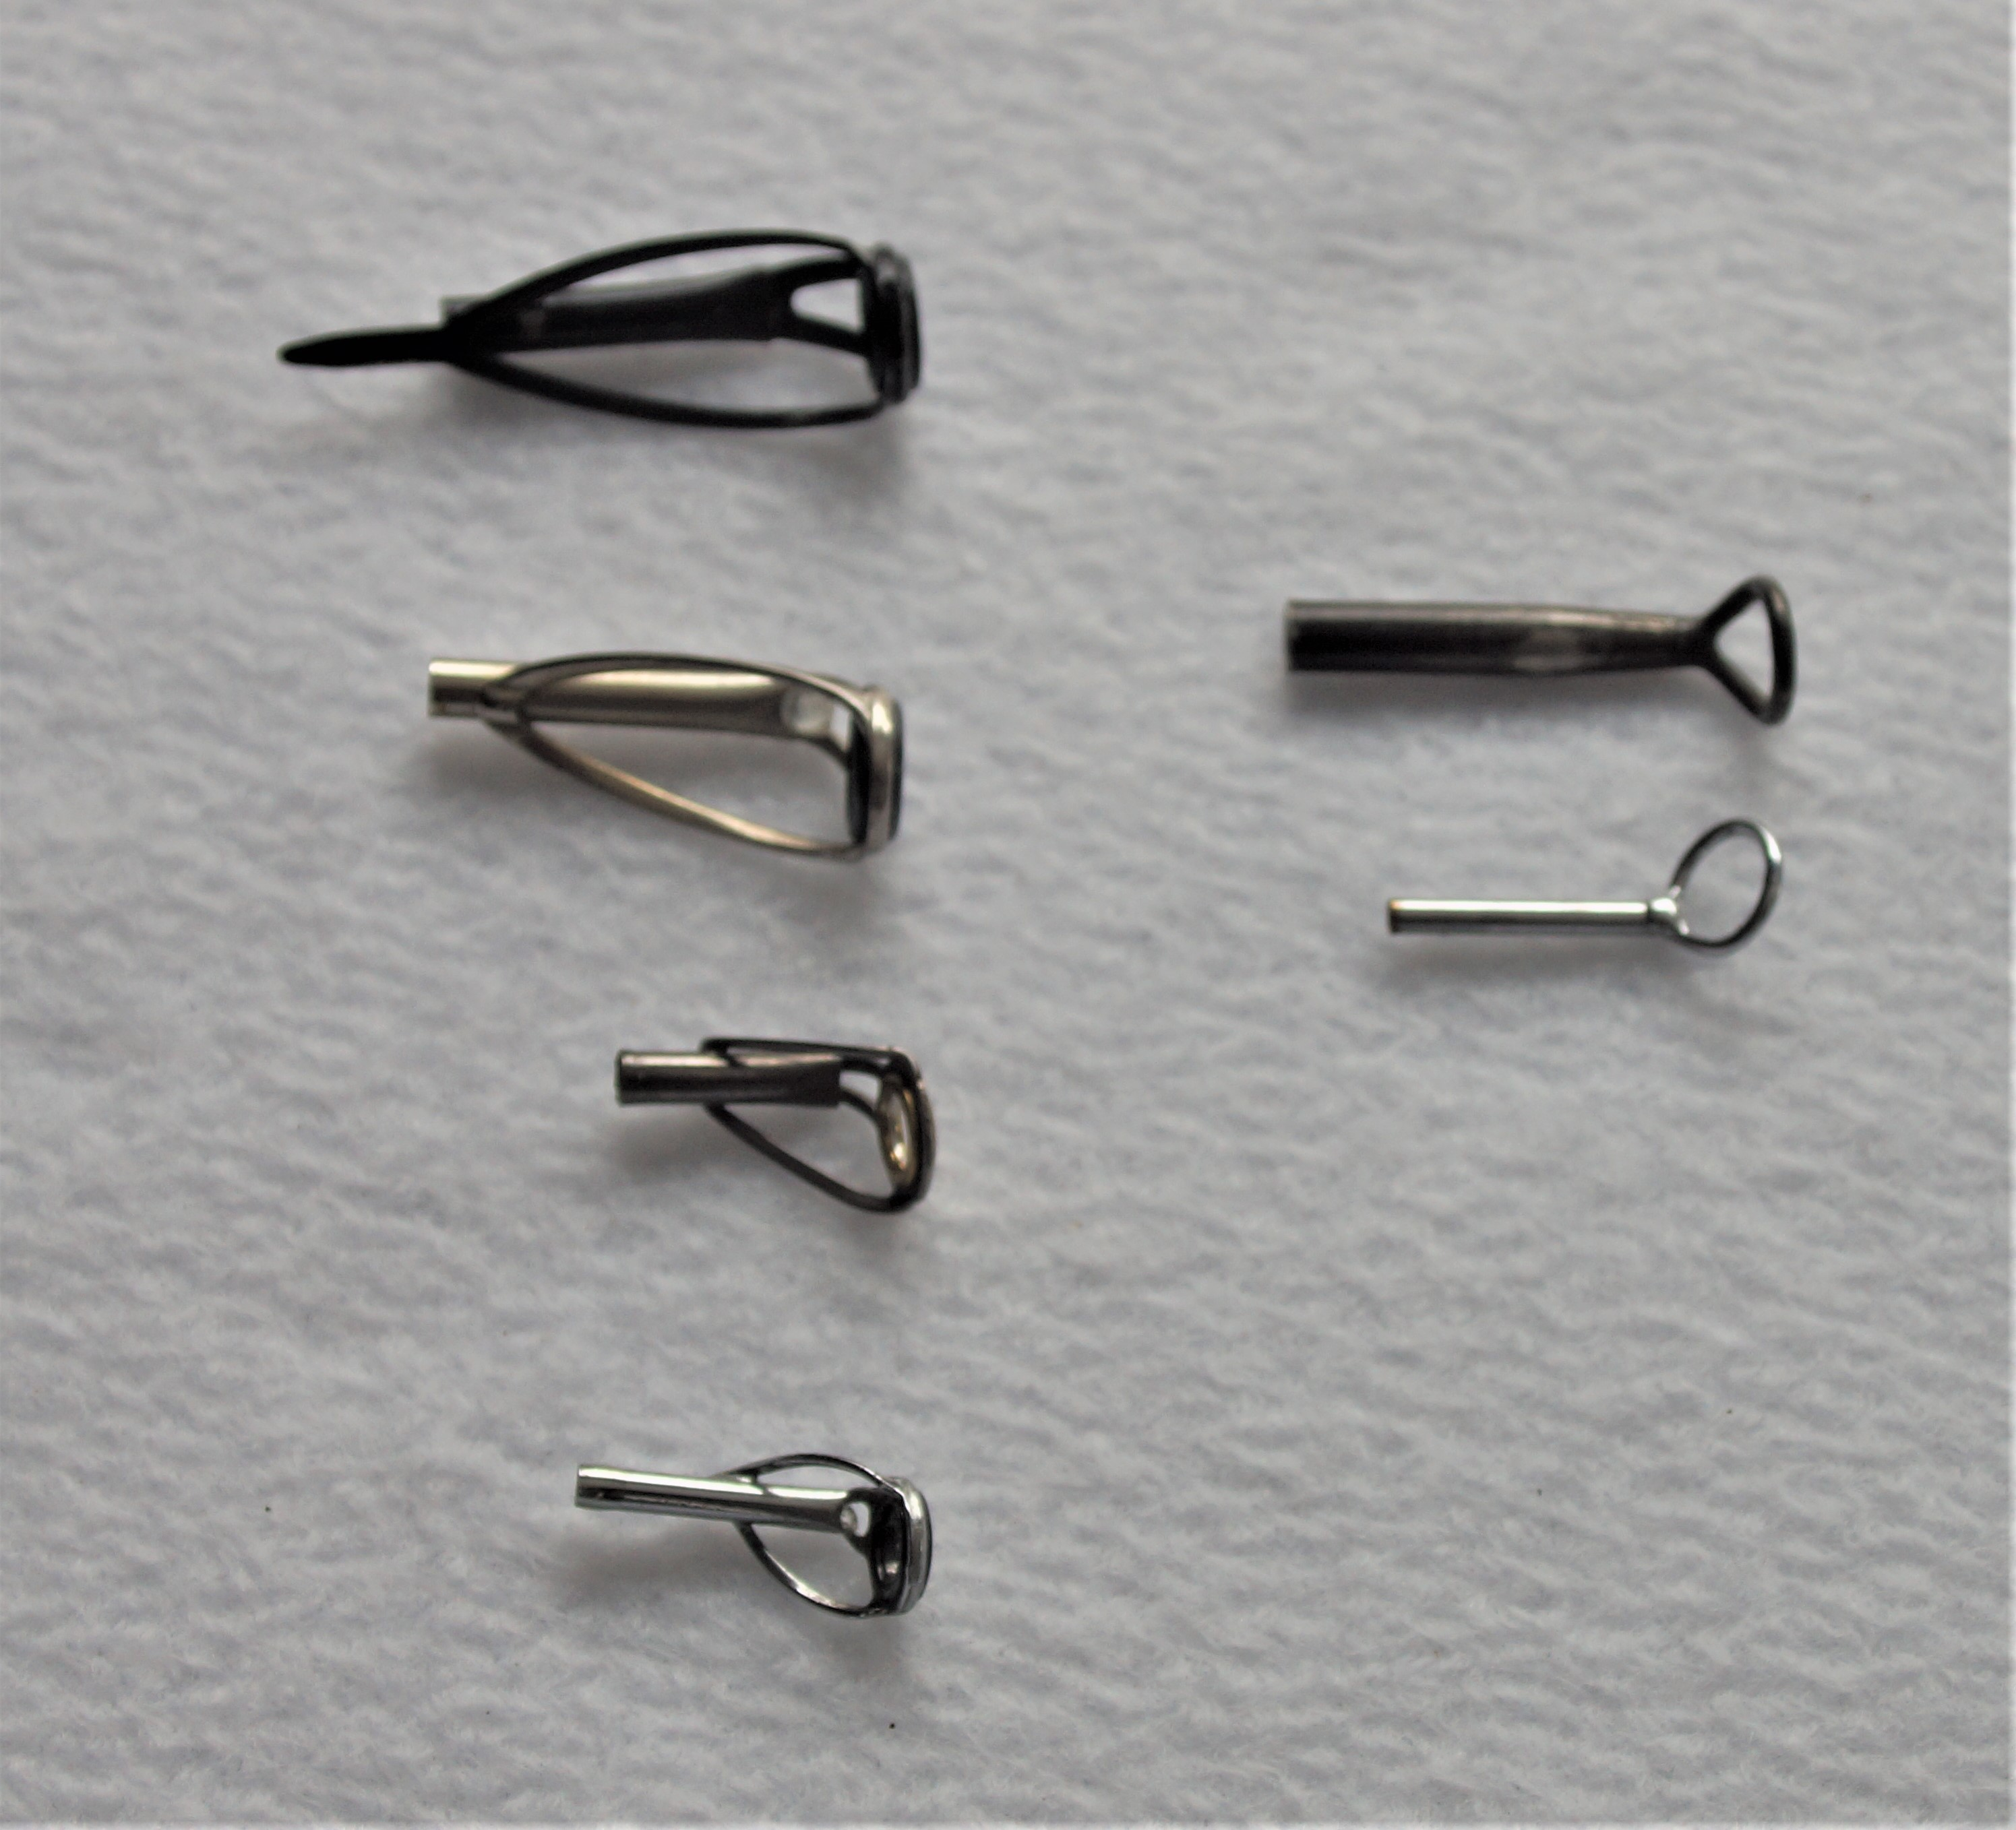
Rod Components: Tip Tops
The left column is an assortment of spinning or casting Tip Tops. It is all about your personal preference on what you like to use. The right column is Fly Rod Tip Tops.

Slide 13
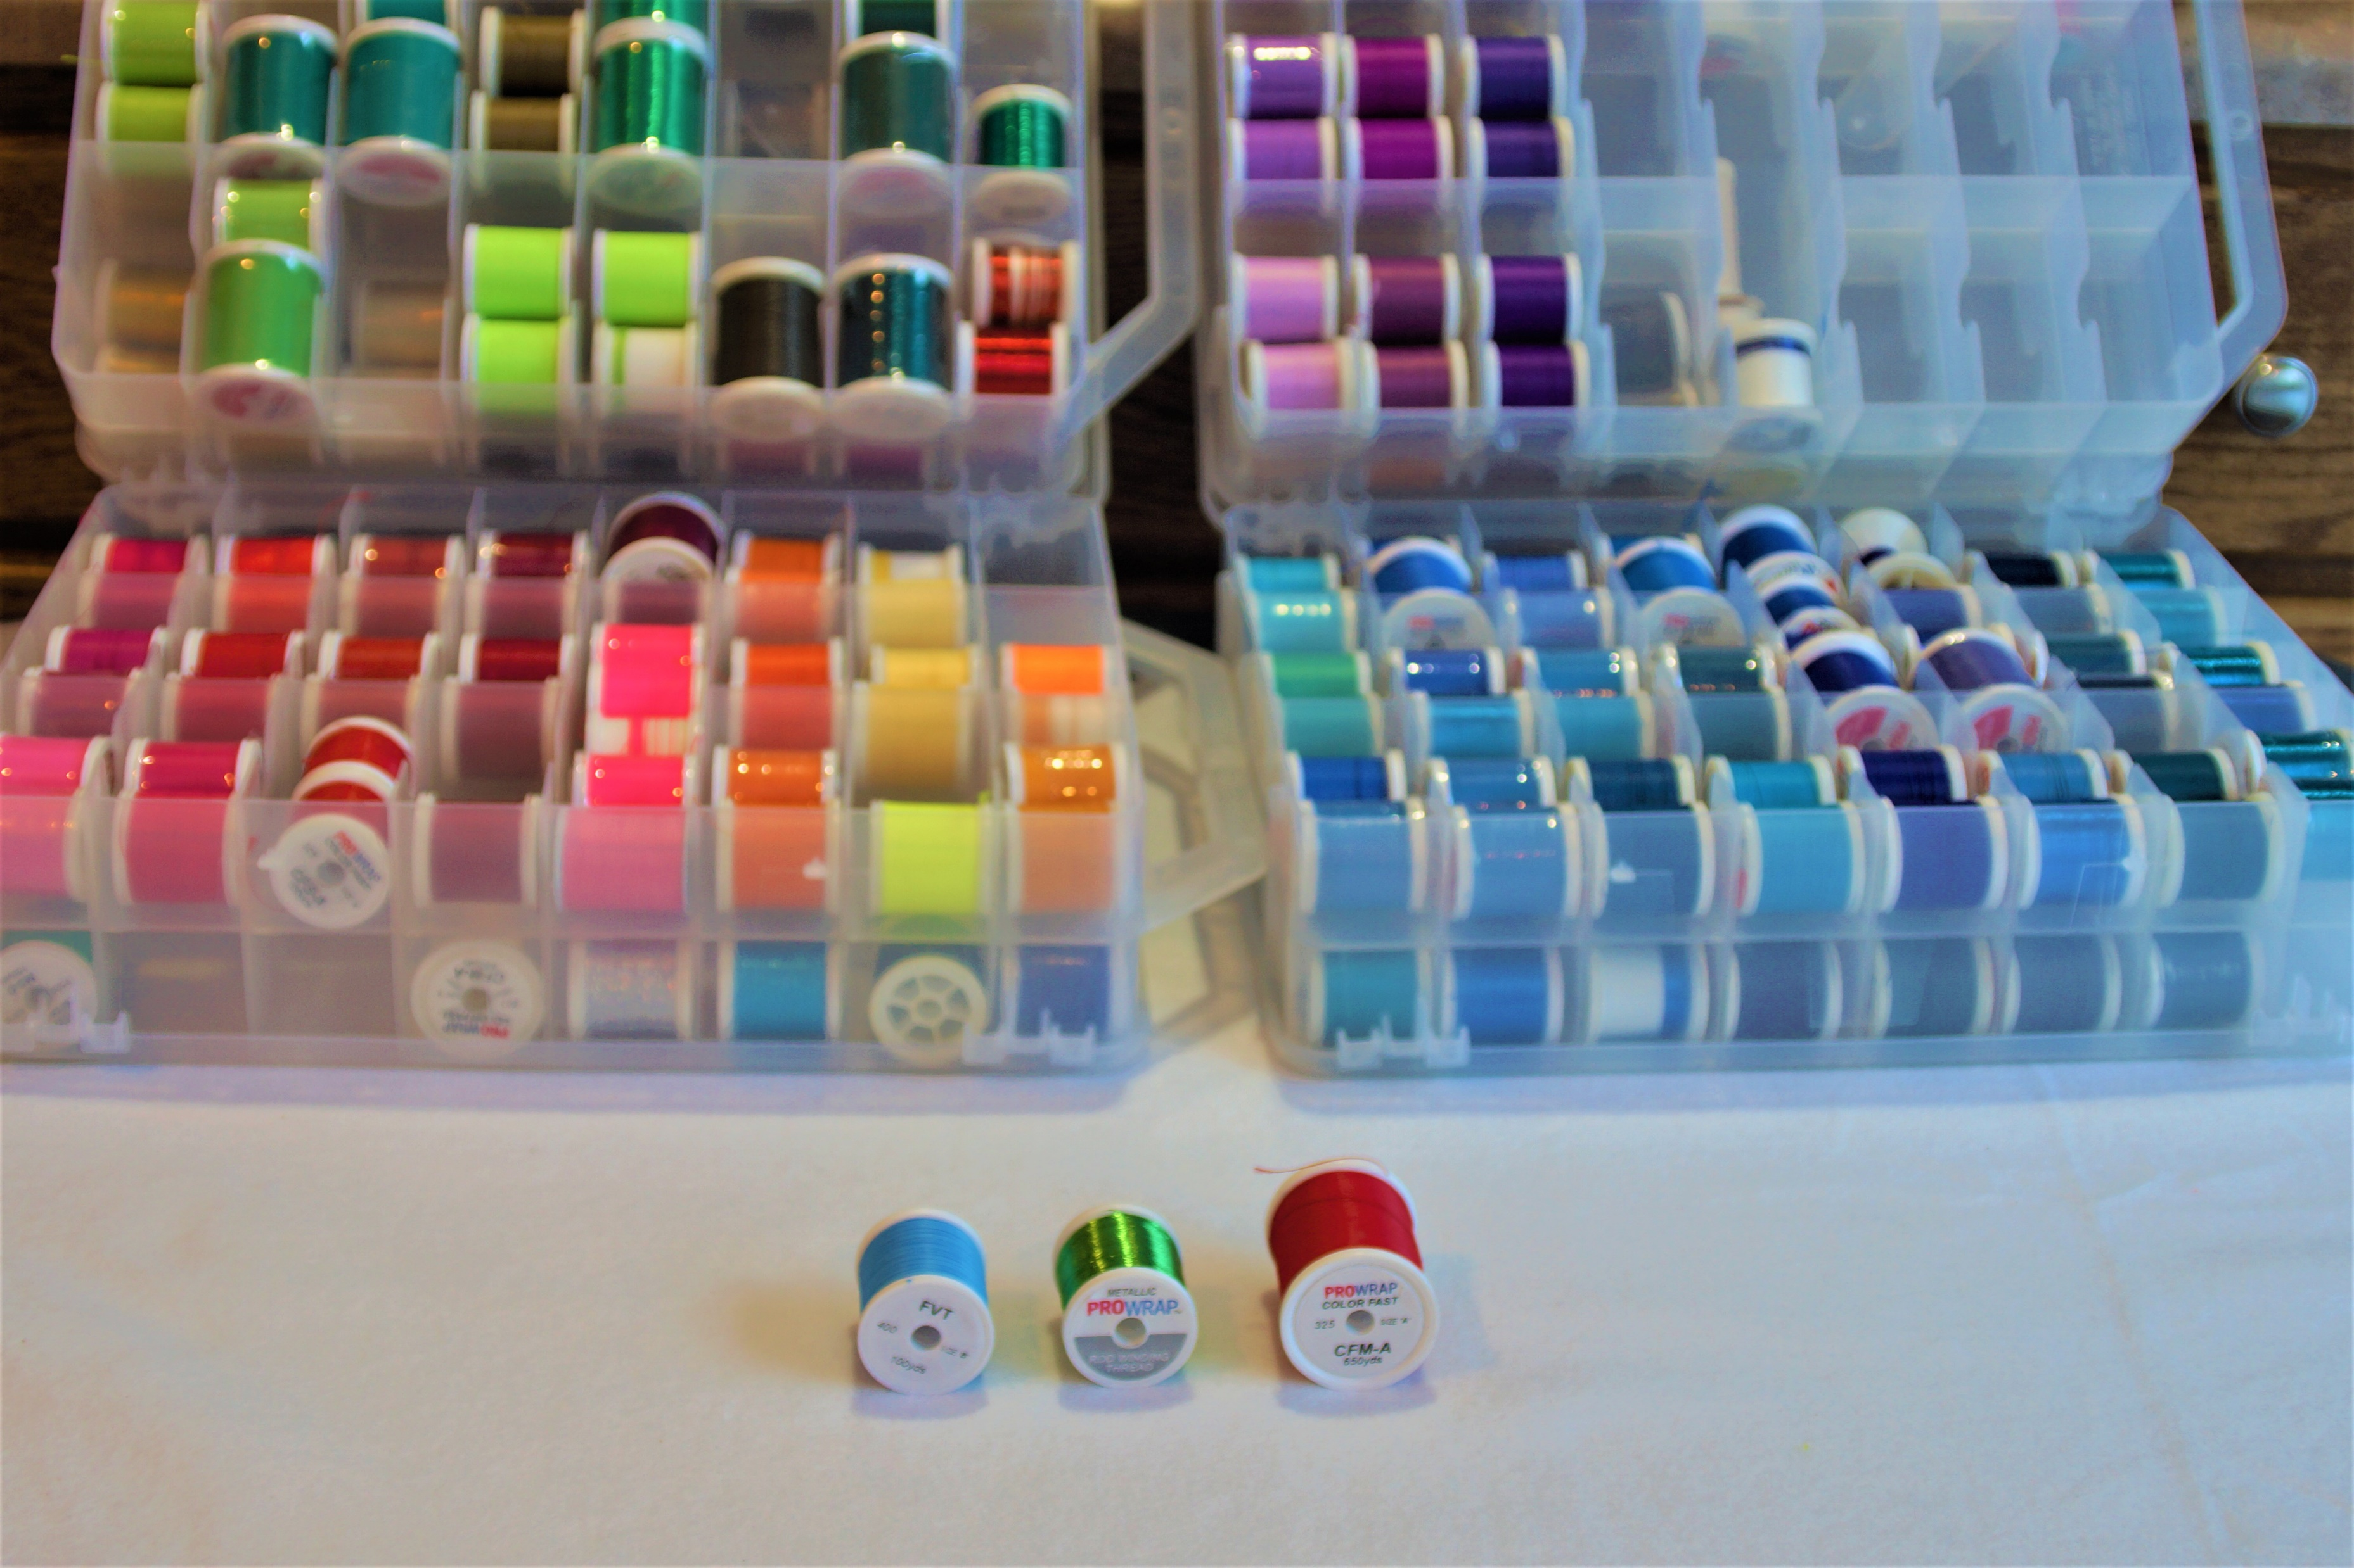
Rod Components: Thread
The thread used for wrapping guides comes in many colors and styles. Nylon is the most common type of thread. These threads differ from sewing thread. I recommend thread with a color preserver added. Thread without color preserver becomes
translucent when epoxy is applied. The most common thread sizes are “A” or “D”. “D” is heavier and may be preferred in heavy saltwater rods.

